Slide 1


Financial Highlights
As of June 30, 2022
One Minute Report – Click Below
(in progress) | June 22 Financial Highlights | ShowMe

Slide 2

Highlights of Interim Financial Report (unaudited)
June 30, 2022
BUDGET AMENDMENT REPORT for the July 20, 2022
Board meeting

Slide 3
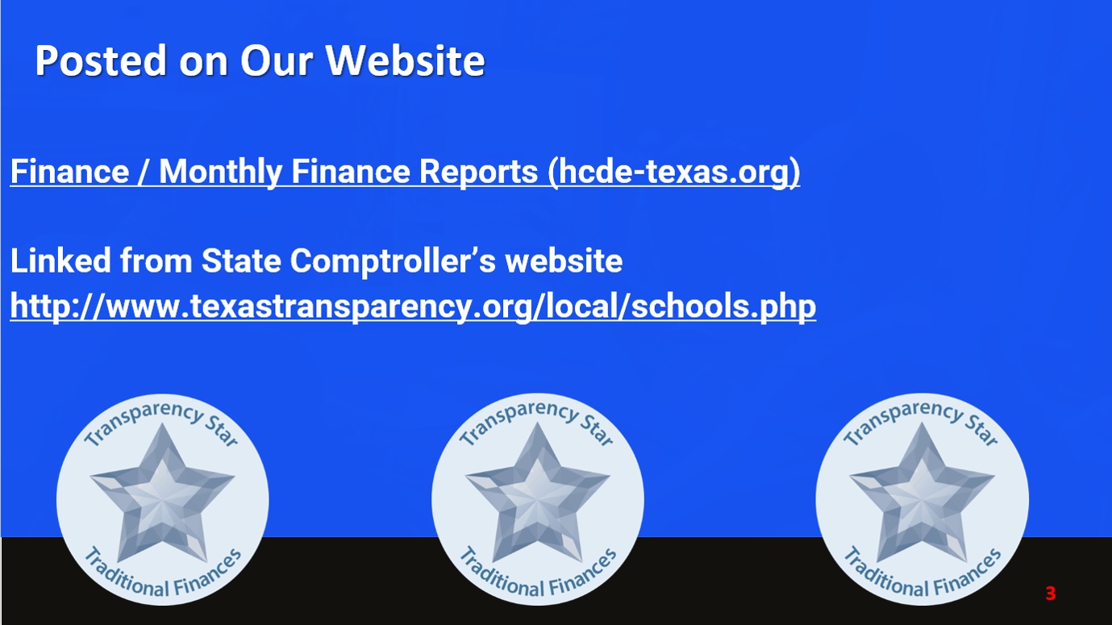
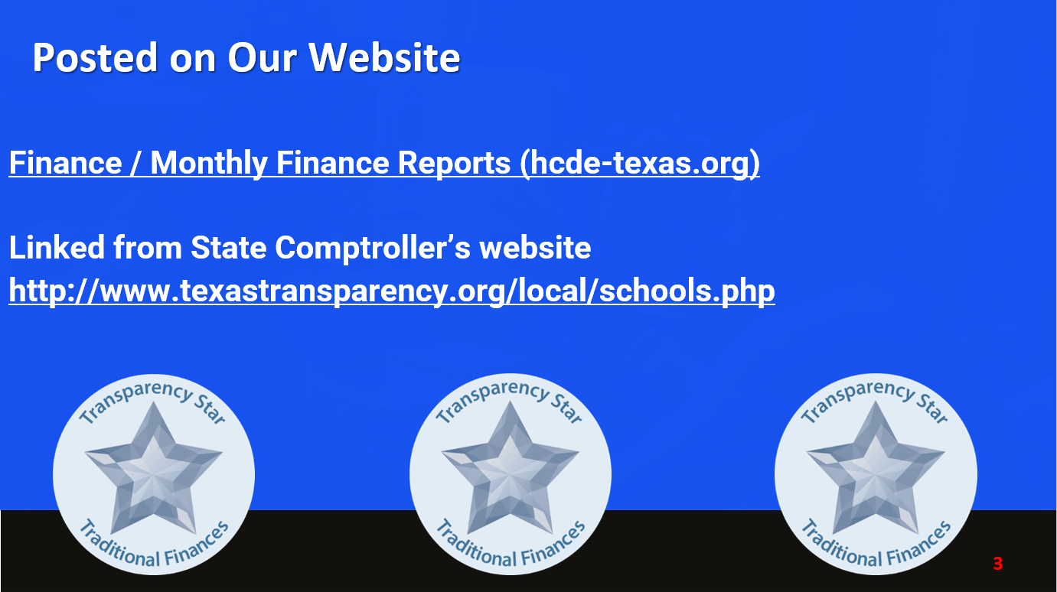



Posted on Our Website
Finance / Monthly Finance Reports (hcde-texas.org)
Linked from State Comptroller’s website
http://www.texastransparency.org/local/schools.php

Slide 4
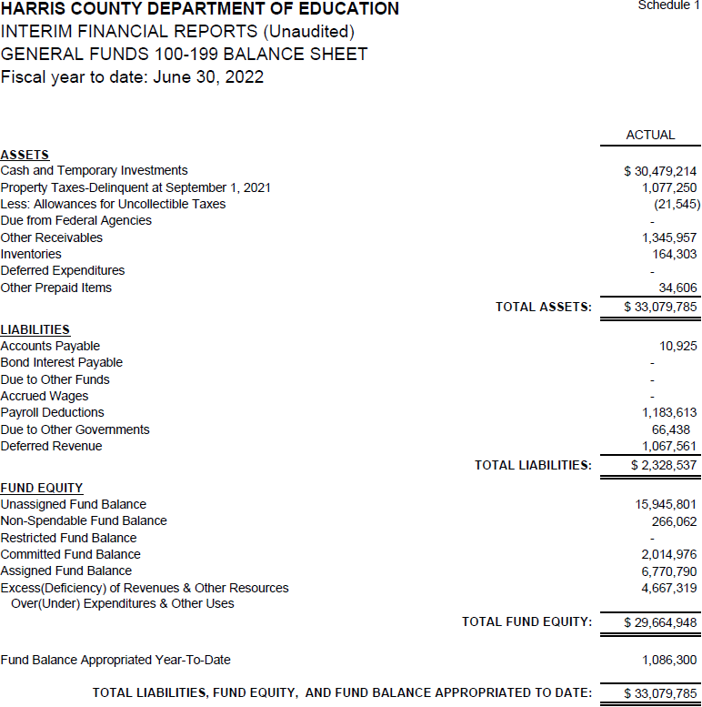

INTERIM FINANCIAL REPORT
(unaudited)
GENERAL FUND
Balance Sheet as of June 30, 2022
Total Assets:
$ 33,079,785
Total Liabilities:
$ 2,328,537

Slide 5
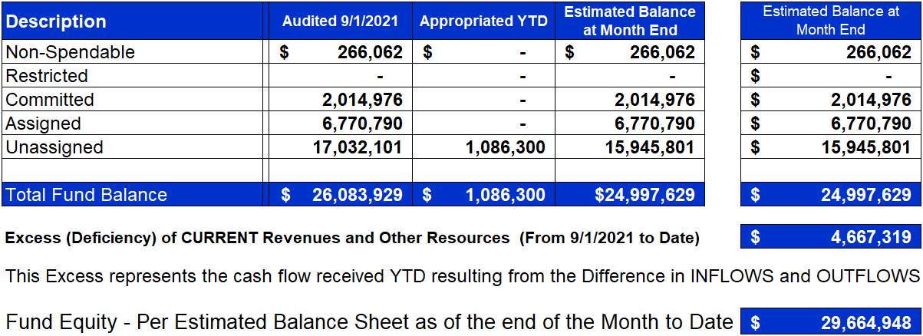
INTERIM FINANCIAL REPORT (unaudited)
ASST. SUPERINTENDENT FOR BUSINESS SERVICES MESSAGE
As of June 30, 2022
The ESTIMATED General Fund balance at 06/30/2022 is $29,664,948 after current appropriations.
As year end adjustments are completed, a budget amendment will be submitted to the board for items assigned, restricted and committed that will roll forward into FY 2023.

Slide 6

INTERIM FINANCIAL REPORT (unaudited)
As of June 30, 2022
Financial Ratios
Level One - Indicator of Financial Strength
Level Two - Indicator of Efficient Leverage
Level Three - Indicators of Efficiency
Level Four - Indicators of Revenue Growth

Slide 7

INTERIM FINANCIAL REPORT (unaudited)
As of June 30, 2022
Indicators of Financial Strength
Percent of Fund Balance to G/F
Expenditures Ratio
What is the percent of rainy fund balance? (*)Unadjusted
Working Capital Ratio
What is the cash flow availability for the organization?
Unassigned Fund Balance $15,945,801
Total G/F Expenditures $44,899,142
Goal : > 30% of G/F Exp.
Benchmark: 10% to 29%
Danger: Under 10%
Goal : >$15,000,000
Benchmark : $10M to $15M
Danger : Under < $10M
Total Current Assets
Less Total Current Liabilities
$33,079,785– 2,328,537 = 30,751,248
36% FY22
42% FY21
$31M FY22
$41M FY21
Budgeted 24%
Details on Schedule 3
Budgeted $33M
Details on Schedule 1

Slide 8
INTERIM FINANCIAL REPORT (unaudited)
As of June 30, 2022
Indicators of Efficient Leverage Reserves
Unassigned Fund Balance Ratio
How much is available in reserves?
Debt to Income Ratio
What is the ability of HCDE to cover its debt payments?
Unassigned Fund Balance $15,945,801
Total Fund Balance $30,751,248
Annual Principal and Interest Payments on
Term Debt and Capital Leases $3,983,840
G/F Revenue Less Facility Charges
49,566,461 - 4,561,133
Goal: <75%
Benchmark: 50% to 75%
Danger: <50%
Goal: <25% of annual revenue
Benchmark: 25% to <49%
Danger: Over > 50%
52% FY22
43% FY21
8.9% FY22
8.0% FY21
Budgeted 57%
Details on Schedule 1
Budgeted 10%
Details on Schedule 5

Slide 9
INTERIM FINANCIAL REPORT (unaudited)
As of June 30, 2022
Indicators of Efficiency
Tax Revenue to Total Revenue Ratio
How efficient is HCDE at leveraging local
taxes? (Current)
Indirect Cost to Tax Ratio
How much dependency on indirect cost from grants?
Current Tax Revenue $25,230,527
Indirect Cost General Fund $1,486,654
Total Revenue $88,461,089
Total General Fund Revenues $49,566,461
Goal: <20% of revenue
Benchmark: 20% to 30%
Danger: Over >30%
Goal: >5%
Benchmark: 2% to 5%
Danger: Under < 2%
29% FY22
29% FY21
3% FY22
3% FY21
Budgeted 20%
Details on Schedule 2
Budgeted 3%
Details on Schedule 3

Slide 10
INTERIM FINANCIAL REPORT (unaudited)
As of June 30, 2022
Indicators of Revenue Growth
Fee for Service Revenue Ratio
How are revenues spread across all Funds?
Fee for Service Revenue Growth Ratio
What is the market growth for fee on services?
Total Fee for Service Revenues (G/F) $18,310,635
Total Revenues $88,461,089
Fee for Service Current Year Less Fee for Services Last Year $16,463,101 - 17,069,841
Fees for Service Last Year $17,069,841
Goal: >30% of annual revenue Benchmark: 10% to 29%
Danger: Under 10%
Goal: >3% of + growth
Benchmark: 0% to 3%
Danger: Under 0%
21% FY22
22% FY21
0% FY22
-9% FY21
Budgeted 17%
Details on Schedule 14
Budgeted -5%
Details on Schedule 14

Slide 11
FY 2021-2022
Fund Balance
-
Budgeted Activity

Slide 12
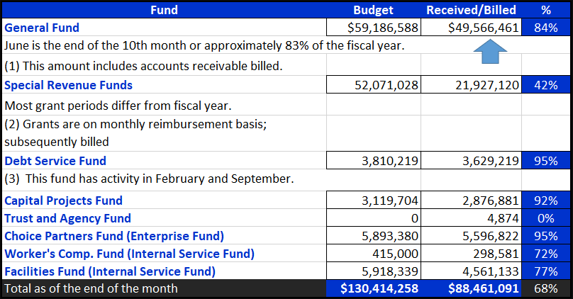
INTERIM FINANCIAL REPORT (unaudited)
GENERAL, SPECIAL REVENUE, DEBT SERVICE FUNDS, CAPITAL PROJECTS,
AND INTERNAL SERVICE FUNDS
REVENUES (INFLOWS)
Budget to Actual for period ending June 30, 2022

Slide 13
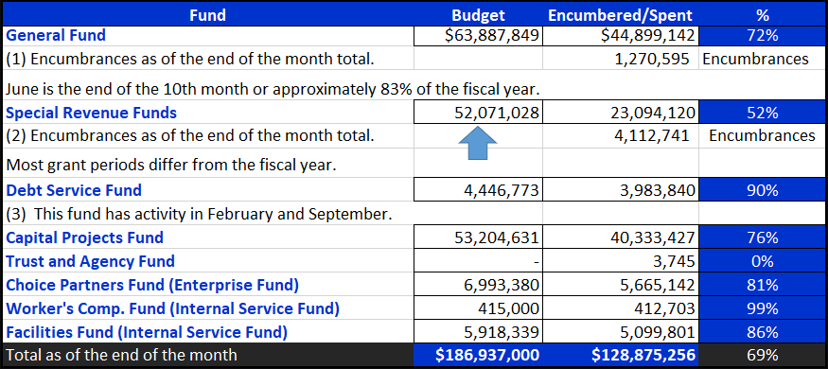
INTERIM FINANCIAL REPORT (unaudited)
GENERAL, SPECIAL REVENUE, DEBT SERVICE FUNDS, CAPITAL PROJECTS,
AND INTERNAL SERVICE FUNDS
Expenditures (OUTFLOWS)
Budget to Actual for period ending June 30, 2022

Slide 14
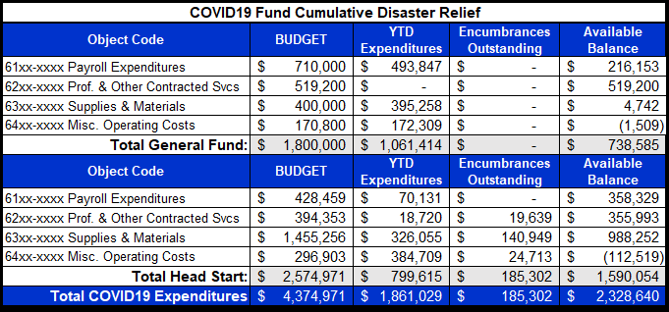
INTERIM FINANCIAL REPORT (unaudited) FY 2021&22 COVID19 Budget to Actual –
Expenditures
for period ending June 30, 2022
Incentives to be
paid in Fall 2022

Slide 15
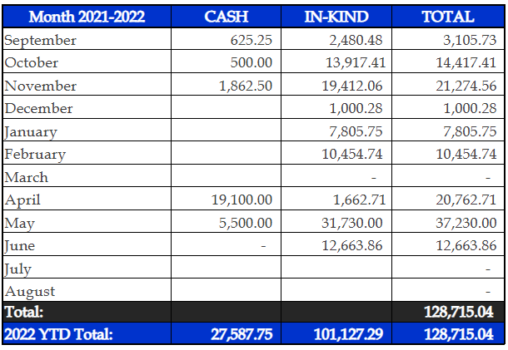
INTERIM FINANCIAL REPORT (unaudited)
FY 2021-22 Donations Report
All Funds as of June 30, 2022

Slide 16
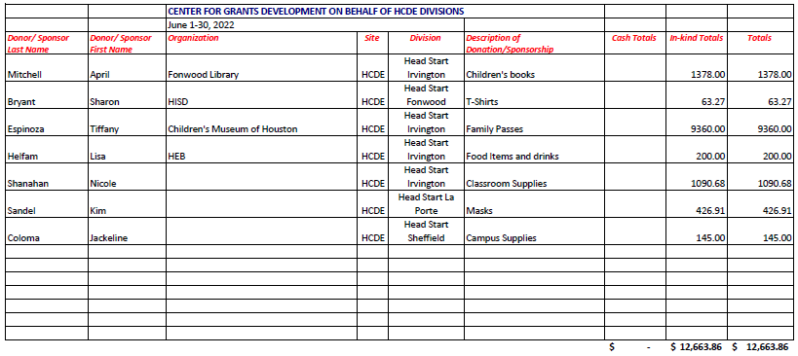
INTERIM FINANCIAL REPORT (unaudited)
FY 2021-22 Donations Report
All Funds as of June 30, 2022

Slide 17
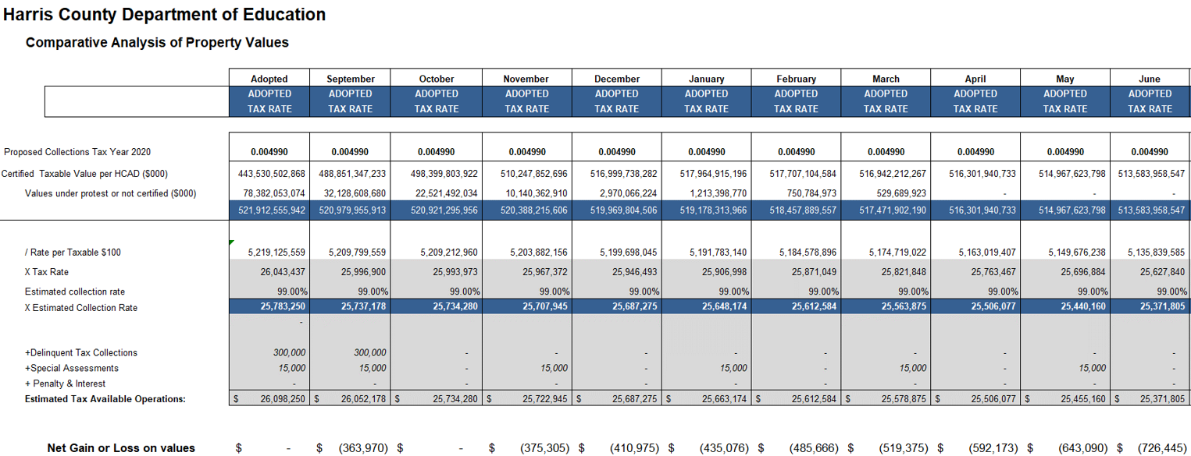
INTERIM FINANCIAL REPORT (unaudited)
TAX COLLECTIONS COMPARATIVE ANALYSIS
Fiscal Year-To-Date as of June 30, 2022
$513.6 B
See Tax Calculator at:
https://hcde-texas.org/transparency/tax-rate/
17

Slide 18
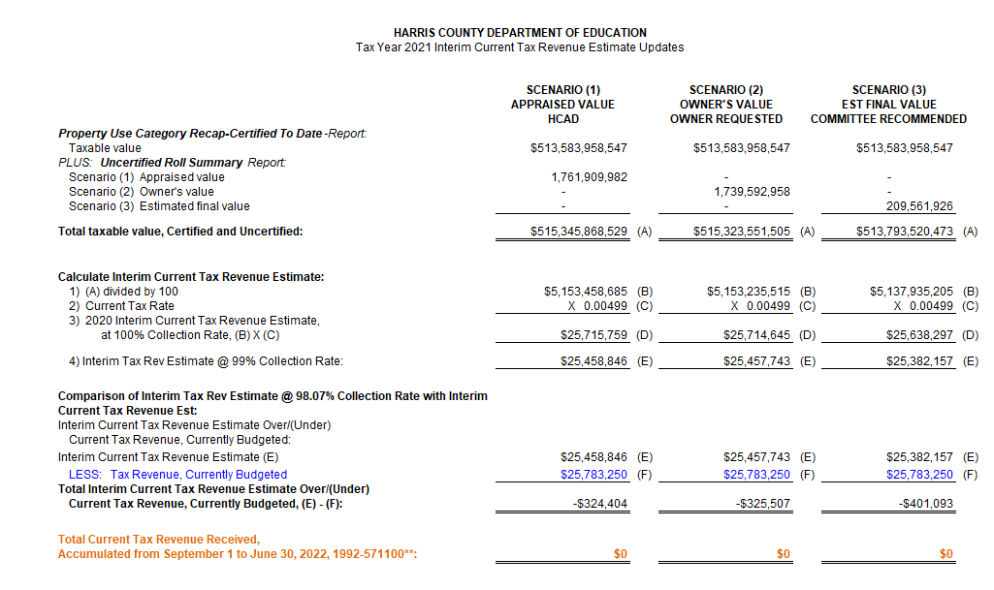
INTERIM FINANCIAL REPORT (unaudited) TAX COLLECTIONS
Fiscal Year-To-Date as of June 30, 2022
(10th month / 12 months)

Slide 19
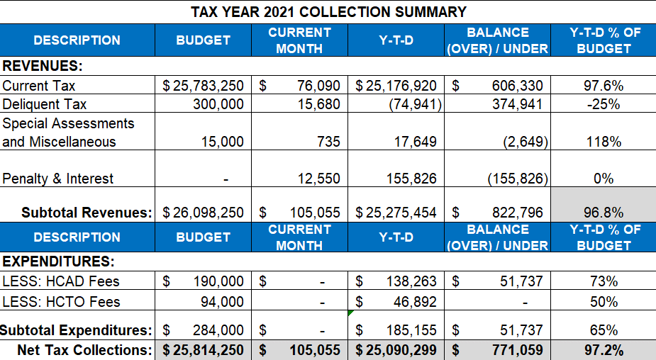
INTERIM FINANCIAL REPORT (unaudited) TAX COLLECTIONS
Fiscal Year-To-Date as of June 30, 2022
(10th month / 12 month)
a) 2021 Tax Rate = $0.004990/$100 Property Assessment/Appraisal - --> Annual Tax on a $249,978 - $67,494 = $182,484/100 x .004990 =
Residential Property = $9.11 (net of 27% homestead exception.)
b) $705,000/$25,188,000 = 2.80% Collection and assessment costs

Slide 20
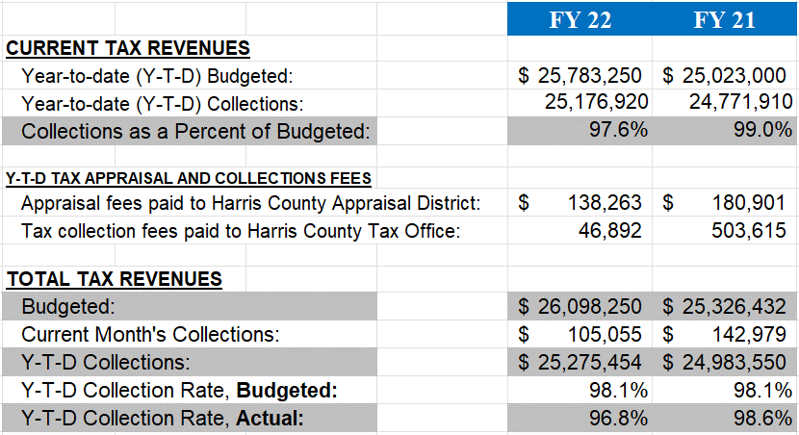
INTERIM FINANCIAL REPORT (unaudited) TAX COLLECTIONS
Fiscal Year-To-Date as of June 30, 2022
(10th month / 12 month)
a) 2021 Tax Rate = $0.004990/$100 Property Assessment/Appraisal - --> Annual Tax on a $249,978 - $67,494 = $182,484/100 x .004990 =
Residential Property = $9.11 (net of 27% homestead exception.)
b) $705,000/$25,188,000 = 2.80% Collection and assessment costs

Slide 21

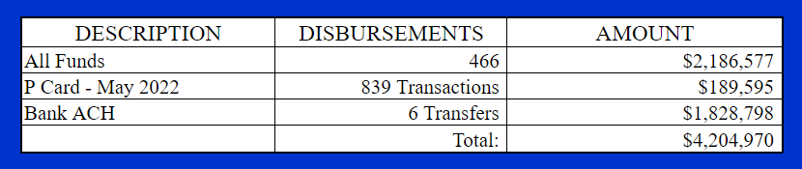
INTERIM FINANCIAL REPORT (unaudited)
DISBURSEMENT – ALL FUNDS
June 30, 2022
Notes:
All Purchase Orders and Payment Authorizations are reviewed before disbursement.
All Procurement Card charges are reviewed by cardholder, supervisor, and business office staff each month.
A report on CH Local Expenditures is included in the monthly report.

Slide 22
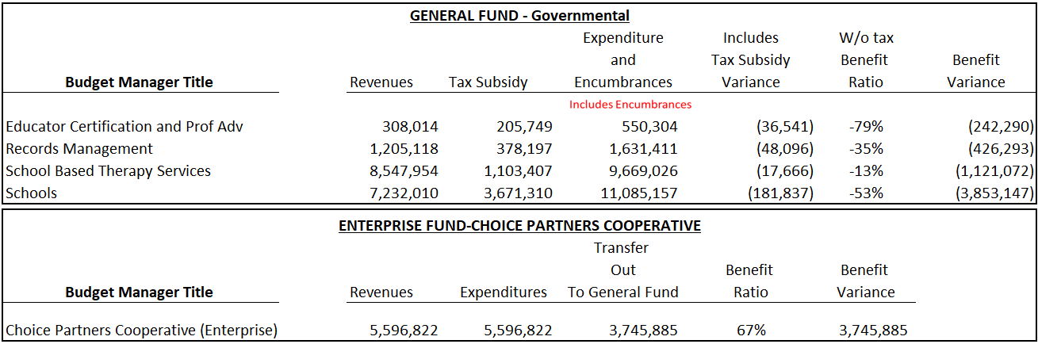
INTERIM FINANCIAL REPORT (unaudited)
Segment Division Data
As of June 30, 2022

Slide 23
HIGHLIGHTS OF BUDGET AMENDMENT REPORT
July 20, 2022 Board Meeting
(unaudited)
Amendments
There were no budget amendments for the month of July

Slide 24

Education Foundation Update
June 30, 2022

Slide 25
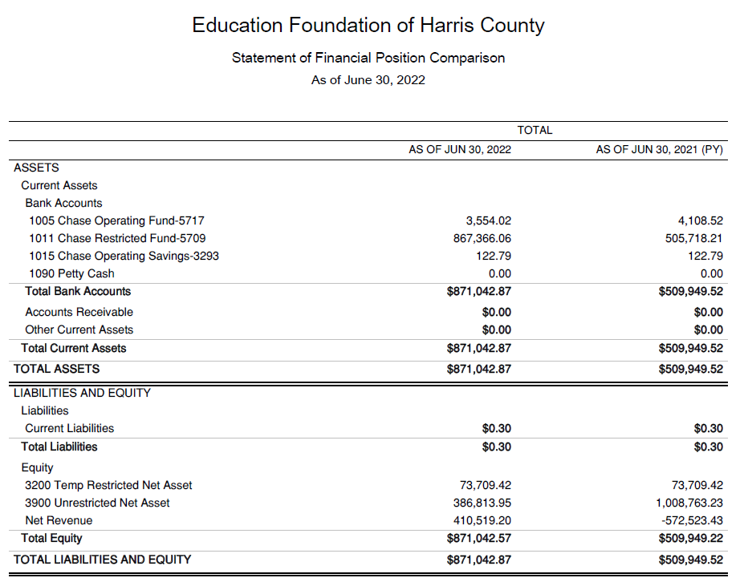
Statement of Financial Position
Net Equity $871,043

Slide 26
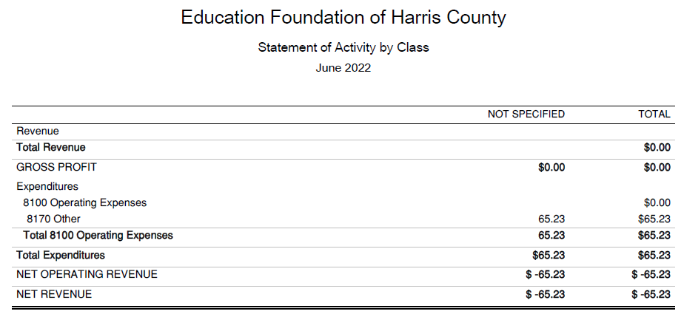
Statement of Activities Classified

Slide 27
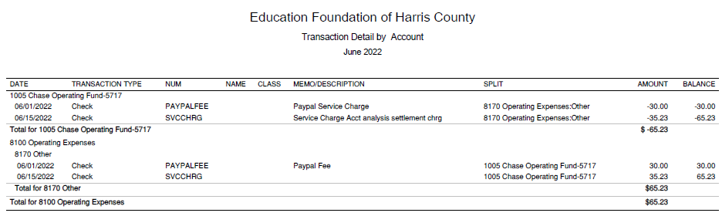




Transaction Detail by Inflow & Outflow

Slide 28
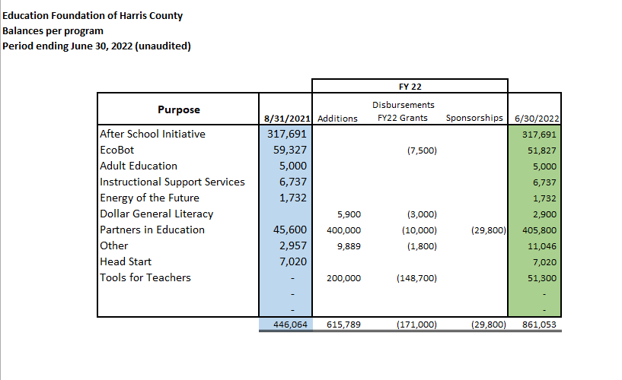
Balances Per Program

Slide 29

PFC & Lease Revenue Projects Update
June 30, 2022

Slide 30
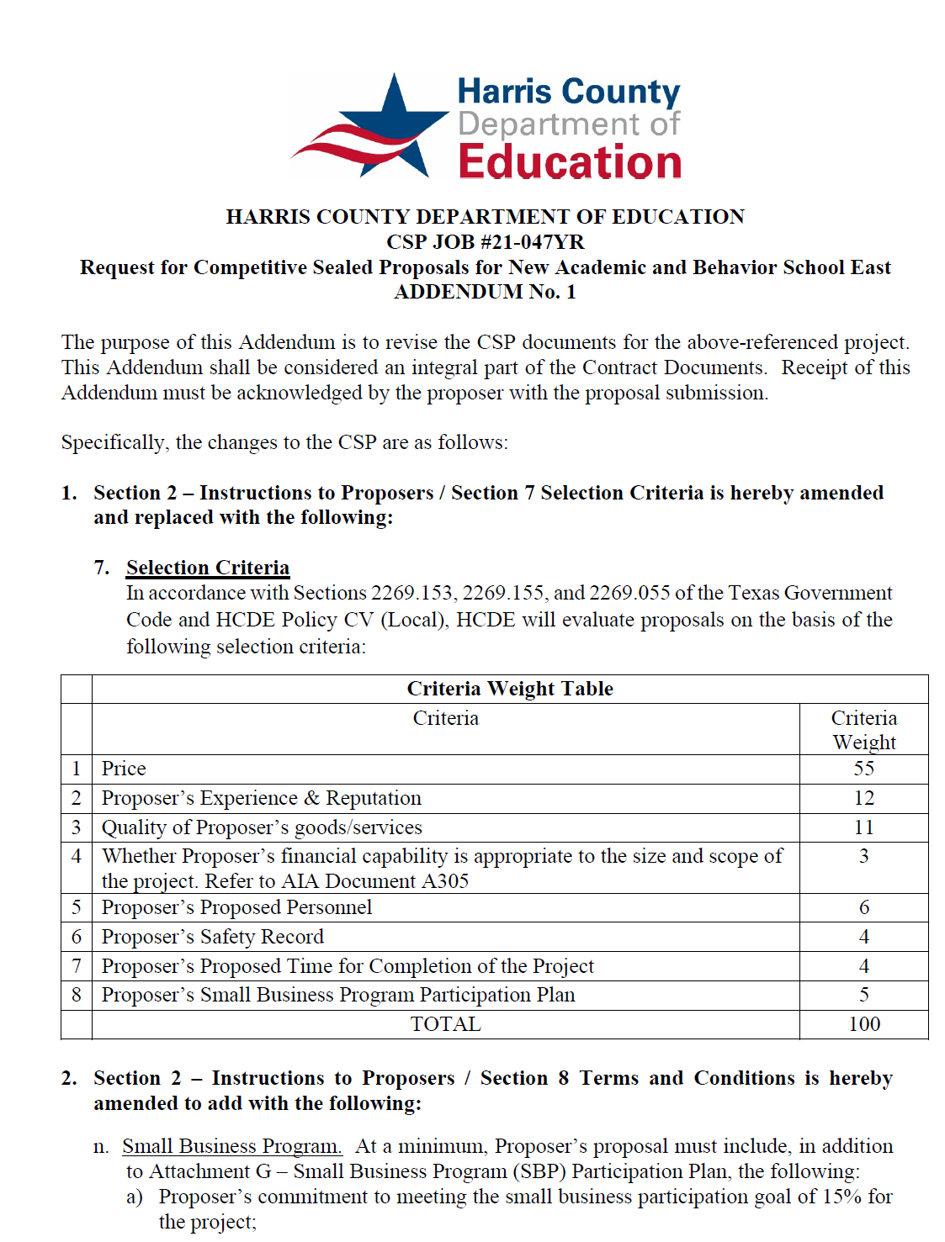
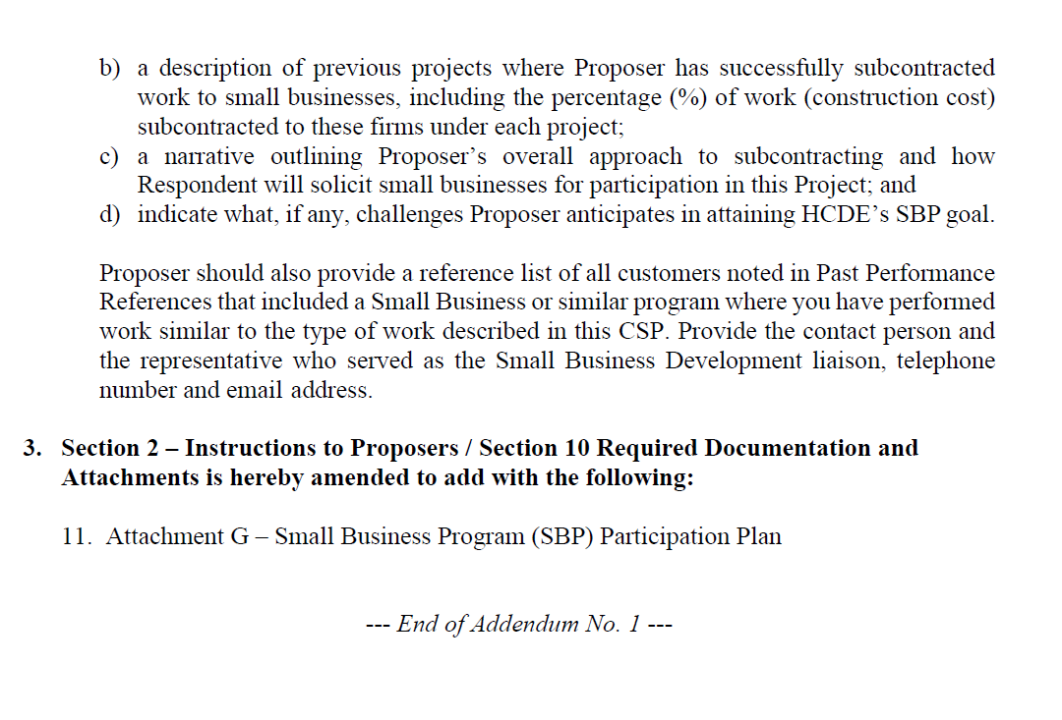
Small Business
Program for construction
Launch industry's first collaboration feature
This is our plan as we launch the industry's first collaboration feature

Slide 31
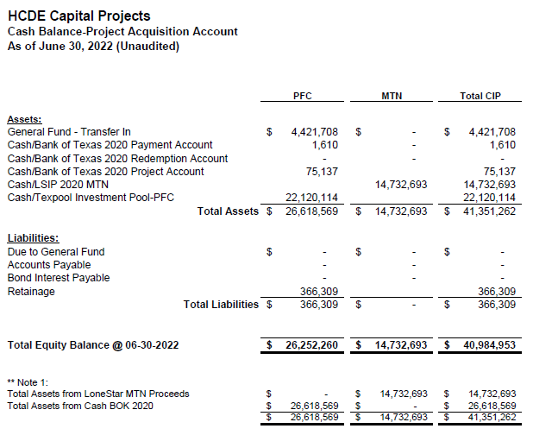

AB East School Contract $12,358,000 Awarded and Signed
Adult Ed Center Contract $15,121,000 awarded on Oct 2021 Board Mtg
HP East Contract $7,271,000 awarded on Nov 2021
Irvington – Pending Architect Assignment
Cash Balance –
Project Acquisition Account
As of June 30, 2022

Slide 32
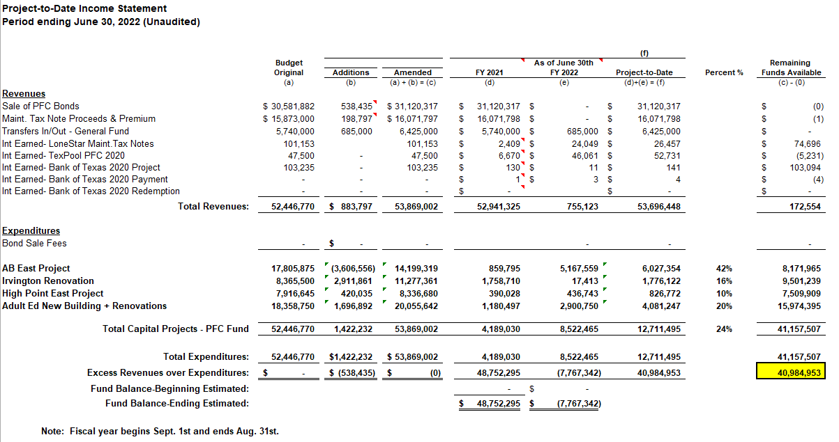
Income Statement– Project Acquisition Account
As of June 30, 2022

Slide 33
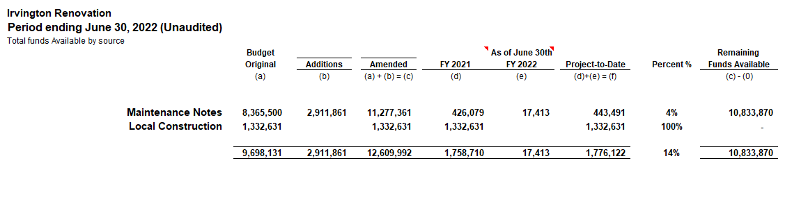
Irvington Renovation – Funds by Source
As of June 30, 2022

Slide 34

Capital Program Proposal from Aug 3, 2020

Slide 35






2020 Projected Capital Improvement Program
Project | Substantial Completion Date | Project Budget | Maintenance Notes Projected | Revenue Bonds Proceeds | General Funds Use of Fund Bal. | Interest Earnings Projection
Reagan Adm Bldg. | Feb 9, 2023 | $8,365,500 | $ 8,365,500 | N/A | N/A
Adult Ed Building | Oct 25, 2022 | $18,358,750 | $ 3,659,000 | $12,728,598 | $1,870,000 | $101,153
HP East Middle | Oct 25, 2022 | $7,916,645 | $ 1,089,500 | $4,909,645 | $1,870,000 | $47,500
Ab East Campus | Aug 16, 2022 | $17,805,875 | $ 2,759,000 | $12,943,640 | $2,000,000 | 103,235
 | Total | $52,446,770 | $15,873,000 | $30,581,882 | $5,740,000 | $251,888
 |  | Closed on 12-2-20 | Invested in pools.
Build a product accessible on all devices
This is our plan as we build a product accessible on all devices.
Note: The Total Public Notice was $54,000,000. ($35,000,000 for Revenue bonds and $19,000,000 for Maintenance Notes) on August 10, 2020. A transfer of $1,350,000 plus $50,000 in reimbursable expenditures was made from AB East to allocate Program Manager costs to establish the budgets.
Based on Pricing the principal amount will vary due to the premium projected in the bond sale. Revenues Bonds estimated at $27,730,000 and Maintenance Notes for $13,695,000

Slide 36

Interim Financial Report (Unaudited)
I certify that the foregoing information is true and accurate to the best of my knowledge.
/s/ Jesus J. Amezcua, RTSBA,CPA, Ph.D., CPFIM, Asst. Supt. for Business Support Services
/s/ Marcia Leiva, Chief Accounting Officer
/s/ Rubi Platero, MBA, Staff Accountant II

